Slide 1
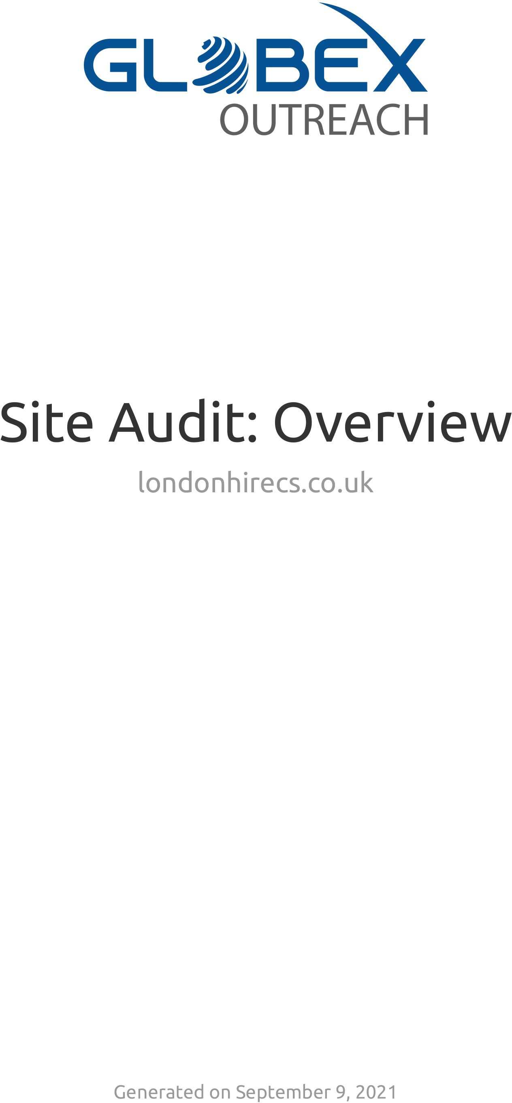

Slide 2
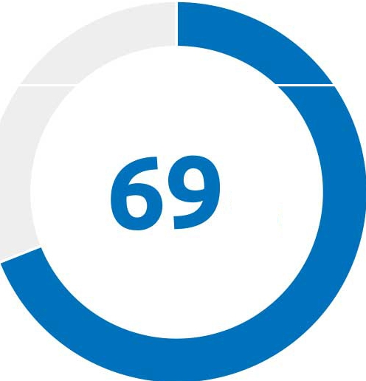
OUTREACH
Site Audit: Overview
Subdomain: londonhirecs.co.uk
Last Update: September 9, 2021
Crawled Pages: 26
Site Health
Crawled Pages
%
Healthy (4)
Broken (1)
Have issues (21)
...., Redirected (0)
Blocked (0)
Errors
Warnings
Notices
32
•
400
•
24
•
0
9 Sep
0
9 Sep
0
9 Sep
Top Issues
8 issues with mixed content
errors
2% of total issues
1 page returned a 4XX status code
errors
0% of total issues
No redirect or canonical to HTTPS homepage from HTTP version
errors
0% of total issues
Generated on September 9, 2021
2

Slide 3
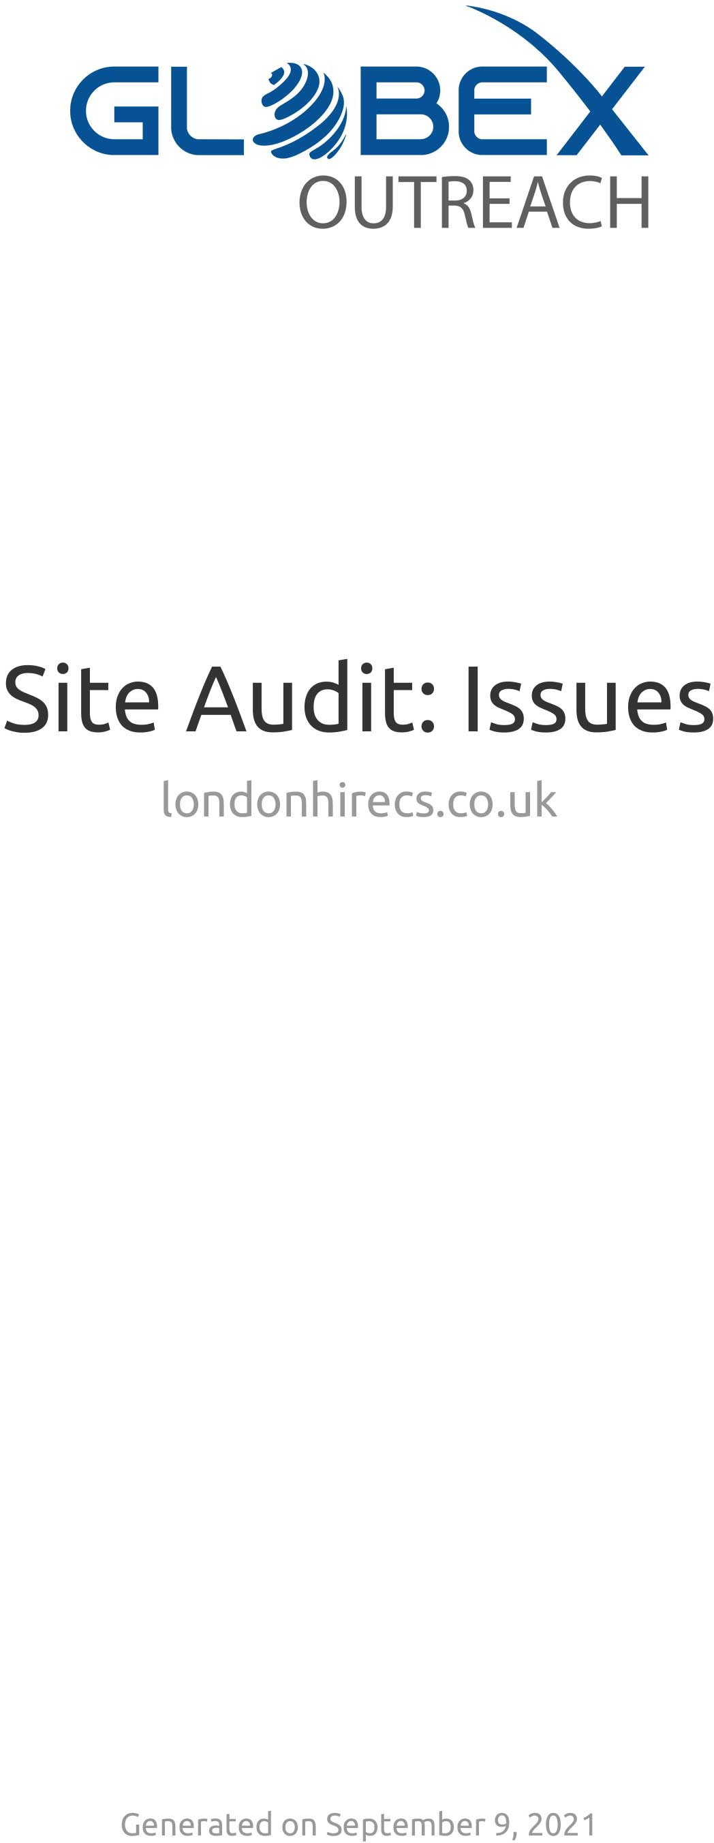

Slide 4
OUTREACH
Site Audit: Issues
Subdomain: londonhirecs.co.uk
Last Update: September 9, 2021
Crawled Pages: 26
londonhirecs.co.uk
8 issues with mixed content
About this issue: If your website contains any elements that are not secured with HTTPS, this may lead to security issues. Moreover, browsers will warn users about loading unsecure content, and this may negatively affect user experience and reduce their confidence in your website. How to
fix: Only embed HTTPS content on HTTPS pages. Replace all HTTP links with the new HTTPS versions. If there are any external links leading to a page that has no HTTPS version, remove those links.
6 pages have duplicate meta descriptions
About this issue: Our crawler reports pages that have duplicate meta descriptions only if they are exact matches. A <meta description> tag is a short summary of a webpage's content that helps search engines understand what the page is about and can be shown to users in search results.
Duplicate meta descriptions on different pages mean a lost opportunity to use more relevant
keywords. Also, duplicate meta descriptions make it difficult for search engines and users to differentiate between different webpages. It is better to have no meta description at all than to
have a duplicate one. How to fix: Provide a unique, relevant meta description for each of your webpages. For information on how to create effective meta descriptions, please see this Google article: https://support.google.com/webmasters/answer/35624
4 issues with duplicate title tags
About this issue: Our crawler reports pages that have duplicate title tags only if they are exact matches. Duplicate <title> tags make it difficult For search engines to determine which of a website's pages is relevant for a specific search query, and which one should be prioritized in search results. Pages with duplicate titles have a lower chance of ranking well and are at risk of being banned. Moreover, identical <title> tags confuse users as to which webpage they should
follow. How to fix: Provide a unique and concise title for each of your pages that contains your most important keywords. For information on how to create effective titles, please see this Google article: https://support.google.com/webmasters/answer/35624

Slide 5
OUTREACH
4 pages have duplicate content issues
About this issue: Webpages are considered duplicates if their content is 85% identical. Having duplicate content may significantly affect your SEO performance. First of all, Google will typically show only one duplicate page, filtering other instances out of its index and search results, and this page may not be the one you want to rank. In some cases, search engines may consider duplicate pages as an attempt to manipulate search engine rankings and, as a result, your website may be downgraded or even banned from search results. Moreover, duplicate pages may dilute your link profile. How to fix. Here are a few ways to fix duplicate content issues: 1. Add a
rel=''canonical'' link to one of your duplicate pages to inform search engines which page to show in search results. 2. Use a 301 redirect from a duplicate page to the original one. 3. Use a
rel=''next'' and a rel=''prev'' link attribute to fix pagination duplicates. 4. Instruct GoogleBot to
handle URL parameters differently using Google Search Console. 5. Provide some unique content on the webpage. For more information, please read these articles: https://support.google.com/webmasters/answer/66359?hl=en and
https://support.google.com/webmasters/answer/139066?hl=en
1 page returned a 4XX status code
About this issue: A 4xx error means that a webpage cannot be accessed. This is usually the result
of broken links. These errors prevent users and search engine robots from accessing your webpages, and can negatively affect both user experience and search engine crawlability. This will in turn lead to a drop in traffic driven to your website. Please be aware that crawler may detect a working link as broken if your website blocks our crawler from accessing it. This usually happens due to the following reasons: 1. DDoS protection system. 2. Overloaded or misconfigured server. How to fix: If a webpage returns an error, remove all links leading to the error page or replace it with another resource. To identify all pages on your website that contain links to a 4xx page, click ''View broken links'' next to the error page. If the links reported as 4xx do work when accessed with a browser, you can try either of the following: 1. Contact your web hosting support team. 2. Instruct search engine robots not to crawl your website too frequently by specifying the ''crawl-delay'' directive in your robots.txt
1 incorrect page found in sitemap.xml
About this issue: A sitemap.xml file makes it easier for crawlers to discover the pages on your
website. Only good pages intended for your visitors should be included in your sitemap.xml file. This error is triggered if your sitemap.xml contains URLs that: 1. lead to webpages with the same content. 2. redirect to a different webpage. 3. return non-200 status code. Populating your file with such URLs will confuse search engines, cause unnecessary crawling or may even result in your sitemap being rejected. How to fix: Review your sitemap.xml for any redirected, non­ canonical or non-200 URLs. Provide the final destination URLs that are canonical and return a 200 status code.
No redirect or canonical to HTTPS homepage from HTTP version
About this issue: If you're running both HTTP and HTTPS versions of your homepage, it is very
important to make sure that their coexistence doesn't impede your SEO. Search engines are not able to figure out which page to index and which one to prioritize in search results. As a result, you may experience a lot of problems, including pages competing with each other, traffic loss and poor placement in search results. To avoid these issues, you must instruct search engines to only index the HTTPS version. How to fix: Do either of the following: 1. Redirect your HTTP page to the HTTPS version via a 301 redirect. 2. Mark up your HTTPS version as the preferred one by adding a rel=''canonical'' to your HTTP pages.
0 pages returned SXX status code

Slide 6
OUTREACH
0 pages don't have title tags
0 internal links are broken
0 pages couldn't be crawled
0 pages couldn't be crawled (DNS resolution issues)
0 pages couldn't be crawled (incorrect URL formats)
0 internal images are broken
Robots.txt file has format errors
0 sitemap.xml files have format errors
0 pages have a WWW resolve issue
This page has no viewport tag
0 pages have too large HTML size
0 AMP pages have no canonical tag
0 issues with hreflang values
0 hreflang conflicts within page source code
0 issues with incorrect hreflang links
0 non-secure pages

Slide 7
OUTREACH
0 issues with expiring or expired certificate
0 issues with old security protocol
0 issues with incorrect certificate name
0 redirect chains and loops
0 pages with a broken canonical link
0 pages have multiple canonical URLs
0 pages have a meta refresh tag
0 issues with broken internal JavaScript and CSS files
0 subdomains don't support secure encryption algorithms
0 sitemap.xml files are too large
0 links couldn't be crawled (incorrect URL formats)
0 structured data items are invalid
0 pages have slow load speed

Slide 8
OUTREACH
londonhirecs.co.uk
133 issues with uncompressed JavaScript and CSS files
About this issue: This issue is triggered if compression is not enabled in the HTTP response. Compressing JavaScript and CSS files significantly reduces their size as well as the overall size of
your webpage, thus improving your page load time. Uncompressed JavaScript and CSS files make your page load slower, which negatively affects user experience and may worsen your search
engine rankings. If your webpage uses uncompressed CSS and JS files that are hosted on an external site, you should make sure they do not affect your page's load time. For more
information, please see this Google article
https://developers.google.com/web/fundamentals/performance/optimizing-content-efficiency. How to fix: Enable compression for your JavaScript and CSS files on your server. If your webpage uses uncompressed CSS and JS files that are hosted on an external site, contact the website owner and ask them to enable compression on their server. If this issue doesn't affect your page load time, simply ignore it.
127 images don't have alt attributes
About this issue: Alt attributes within <img> tags are used by search engines to understand the contents of your images. If you neglect alt attributes, you may miss the chance to get a better placement in search results because alt attributes allow you to rank in image search results. Not using alt attributes also negatively affects the experience of visually impaired users and those who have disabled images in their browsers. For more information, please see these articles: Using ALT attributes smartly: https://webmasters.googleblog.com/2007/12/using-alt-attributes­ smartly.html and Google Image Publishing Guidelines: https://support.google.com/webmasters/answer/114016?hl=en. How to fix: Specify a relevant
alternative attribute inside an <img> tag for each image on your website, e.g., ''<img src=''mylogo.png'' alt=''This is my company logo''>''.
29 issues with unminified JavaScript and CSS files
About this issue: Minification is the process of removing unnecessary lines, white space and comments from the source code. Minifying JavaScript and CSS files makes their size smaller, thereby decreasing your page load time, providing a better user experience and improving your search engine rankings. For more information, please see this Google article https://developers.google.com/web/fundamentals/performance/optimizing-content-efficiency. How to fix: Minify your JavaScript and CSS files. If your webpage uses CSS and JS files that are hosted on an external site, contact the website owner and ask them to minify their files. If this issue doesn't affect your page load time, simply ignore it.
20 HTTP URLs in sitemap.xml for HTTPS site
About this issue: Your sitemap.xml should include the links that you want search engines to find and index. Using different URL versions in your sitemap could be misleading to search engines
and may result in an incomplete crawling of your website. How to fix: Replace all HTTP URLs in your sitemap.xml with HTTPS URLs.
18 links on HTTPS pages leads to HTTP page
About this issue: If any link on website points to the old HTTP version of website, search engines can become confused as to which version of the page they should rank. How to fix: Replace all HTTP links with the new HTTPS versions.

Slide 9
OUTREACH
17 pages have too much text within the title tags
About this issue: Most search engines truncate titles containing more than 70 characters. Incomplete and shortened titles look unappealing to users and won't entice them to click on your page. For more information, please see this Google article: https://support.google.com/webmasters/answer/35624. How to fix: Try to rewrite your page titles to be 70 characters or less.
17 uncompressed pages
About this issue: This issue is triggered if the Content-Encoding entity is not present in the response header. Page compression is essential to the process of optimizing your website. Using
uncompressed pages leads to a slower page load time, resulting in a poor user experience and a lower search engine ranking. How to fix: Enable compression on your webpages for faster load
time.
3 pages have a low word count
About this issue: This issue is triggered if the number of words on your webpage is less than 200. The amount of text placed on your webpage is a quality signal to search engines. Search engines prefer to provide as much information to users as possible, so pages with longer content tend to be placed higher in search results, as opposed to those with lower word counts. For more information, please view this video: https://www.youtube.com/watch?v=w3-obcXkyA4. How to fix: Improve your on-page content and be sure to include more than 200 meaningful words.
2 pages have low text-HTML ratio
About this issue: Your text to HTML ratio indicates the amount of actual text you have on your webpage compared to the amount of code. This issue is triggered when your text to HTML is 10% or less. Search engines have begun focusing on pages that contain more content. That's why a higher text to HTML ratio means your page has a better chance of getting a good position in search results. Less code increases your page's load speed and also helps your rankings. It also helps search engine robots crawl your website faster. How to fix: Split your webpage's text content and code into separate files and compare their size. If the size of your code file exceeds the size of the text file, review your page's HTML code and consider optimizing its structure and removing embedded scripts and styles.
0 external links are broken
0 external images are broken
0 pages don't have enough text within the title tags
0 pages don't have an h1 heading
0 pages have duplicate H1 and title tags
0 pages don't have meta descriptions

Slide 10
OUTREACH
0 pages have too many on-page links
0 URLs with a temporary redirect
0 pages have too many parameters in their URLs
0 pages have no hreflang and lang attributes
0 pages don't have character encoding declared
0 pages don't have doctype declared
0 pages use Flash
0 pages contain frames
0 pages have underscores in the URL
0 outgoing internal links contain nofollow attribute
Sitemap.xml not indicated in robots.txt
Sitemap.xml not found
Homepage does not use HTTPS encryption
0 subdomains don't support SNI
0 issues with blocked internal resources in robots.txt
0 issues with uncached JavaScript and CSS files

Slide 11
OUTREACH
0 pages have a JavaScript and CSS total size that is too large
0 pages use too many JavaScript and CSS files
0 link URLs are too long

Slide 12
OUTREACH
londonhirecs.co.uk
7 pages have only one incoming internal link
About this issue: Having very few incoming internal links means very few visits, or even none, and fewer chances of placing in search results. It is a good practice to add more incoming internal links to pages with useful content. That way, you can rest assured that users and search engines will never miss them. How to fix: Add more incoming internal links to pages with important content.
6 orphaned pages in sitemaps
About this issue: An orphaned page is a webpage that is not linked to internally. Including
orphaned pages in your sitemap.xml files is considered to be a bad practice, as these pages will be crawled by search engines. Crawling outdated orphaned pages will waste your crawl budget. If an orphaned page in your sitemap.xml file has valuable content, we recommend that you link to it internally. How to fix: Review all orphaned pages in your sitemap.xml files and do either of the following: If a page is no longer needed, remove it; If a page has valuable content and brings traffic to your website, link to it from another page on your website; If a page serves a specific need and requires no internal linking, leave it as is.
4 pages have more than one H1 tag
About this issue: Although multiple <h1> tags are allowed in HTMLS, we still donot recommend that you use more than one <h1> tag per page. Including multiple <h1> tags may confuse users.
How to fix: Use multiple <h2>-<h6> tags instead of an <h1>.
2 subdomains don't support HSTS
About this issue: HTTP Strict Transport Security (HSTS) informs web browsers that they can communicate with servers only through HTTPS connections. So, to ensure that you don't serve unsecured content to your audience, we recommend that you implement HSTS support. How to fix: Use a server that supports HSTS.
Robots.txt not found
About this issue: A robots.txt file has an important impact on your overall SEO website's performance. This file helps search engines determine what content on your website they should
crawl. Utilizing a robots.txt file can cut the time search engine robots spend crawling and indexing your website. For more information, please see this Google article: https://support.google.com/webmasters/answer/6062608. How to fix: If you don't want specific content on your website to be crawled, creating a robots.txt file is recommended. To check your robots.txt file, use Google's robots.txt Tester in Google Search Console: https://www.google.com/webmasters/tools/robots-testing-tool
0 pages are blocked from crawling
0 page URLs are longer than 200 characters
0 outgoing external links contain nofollow attributes

Slide 13
OUTREACH
0 pages have hreflang language mismatch issues
0 orphaned pages in Google Analytics
0 pages take more than 1 second to become interactive
0 pages blocked by X-Robots-Tag: noindex HTTP header
0 issues with blocked external resources in robots.txt
0 issues with broken external JavaScript and CSS files
0 pages need more than 3 clicks to be reached
0 URLs with a permanent redirect
0 resources are formatted as page link
0 links on this page have no anchor text
0 links on this page have non-descriptive anchor text
0 links to external pages or resources returned a 403 HTTP status code

